Slide 1


Slide 2


Woodcraft
(Web Application)

Slide 3

GROUP MEMBER INTRODUCTION
Submitted By:
Student Name: NOOR UL NISA
VU ID: BC220401664
Program: BSIT (8th Semester)
Project Group ID: F25PROJECT4708C
Project Title: Woodcraft (Web App)
Supervisor:
Abdul Majid Khokhar

Slide 4

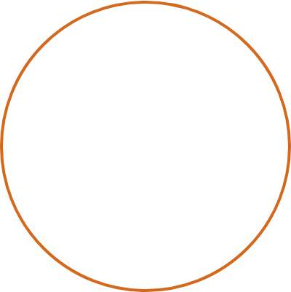


Solo Project Developer
NOOR UL NISA
An 8th-semester BSIT student at the Virtual University of Pakistan, I have spearheaded the design and development of the Woodcraft Management System as a standalone project. My role spans full-stack engineering, database architecture, and UI/UX design.
"Combining traditional artisan craftsmanship with modern digital efficiency."

Slide 5

What is Woodcraft ?
Woodcraft is a professional Web-Application designed to digitize the end-to-end operations of a woodcraft workshop.
It bridges the gap between traditional craftsmanship and modern management by integrating order processing, real-time inventory, and artisan worklogs into one seamless interface.
"Empowering workshops with data-driven decision making."

Slide 6




1. The Digital Need in Woodworking
Manual Inefficiency: Traditional workshops rely on physical registers, leading to lost data, inaccurate inventory levels, and payment discrepancies.
Lack of Transparency: Customers often have no way to track progress without visiting the shop, and employees struggle to prioritize tasks without clear assignments.
Resource Wastage: Without material tracking, wood and hardware are often over-purchased or unavailable when needed.
Project Objective
To build a role-aware dashboard that bridges the gap between traditional craftsmanship and modern digital efficiency through React 18 and MySQL.

Slide 7
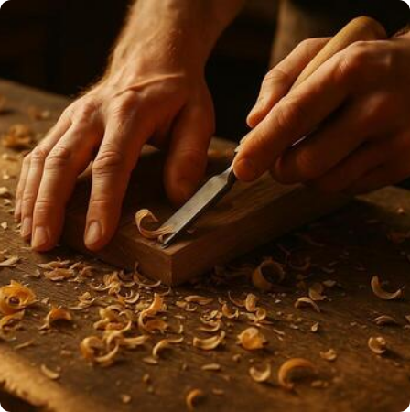
2. Woodcraft Scope & Functional Core
Role-Based Ecosystem: Personalized interfaces for Admins (Management), Customers (Orders), and Employees (Tasks).
Automated Workflow: Real-time conversion of orders into digital invoices with automated balance and wage calculations.
Inventory Management: Dynamic material tracking with "Low Stock" alerts to prevent workshop downtime.
Security & Approval: Secure registration flow where Admins must approve new accounts before system access.

Slide 8
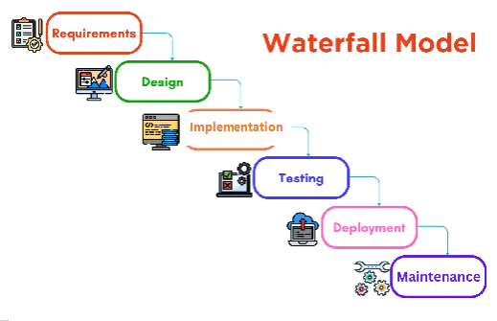
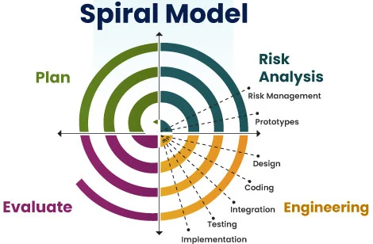
VU Process Model
"Woodcraft” project follows the VU Process Model is a hybrid methodology combining:
1. Waterfall’s structured, phase-by-phase documentation.
2. Spiral’s iterative development and risk analysis.
It follows phases sequentially (like Waterfall) but each phase contains mini-iterations (like Spiral).

Slide 9
Adopted Methodology: VU Process Model
Gathering
Design
Implementation
Reporting
Requirement gathering & analysis.
Architecture, Class, & DB design.
Iterative coding and unit testing.
Final documentation & evaluation.

Slide 10
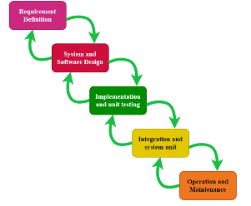
VU Process Model

Slide 11
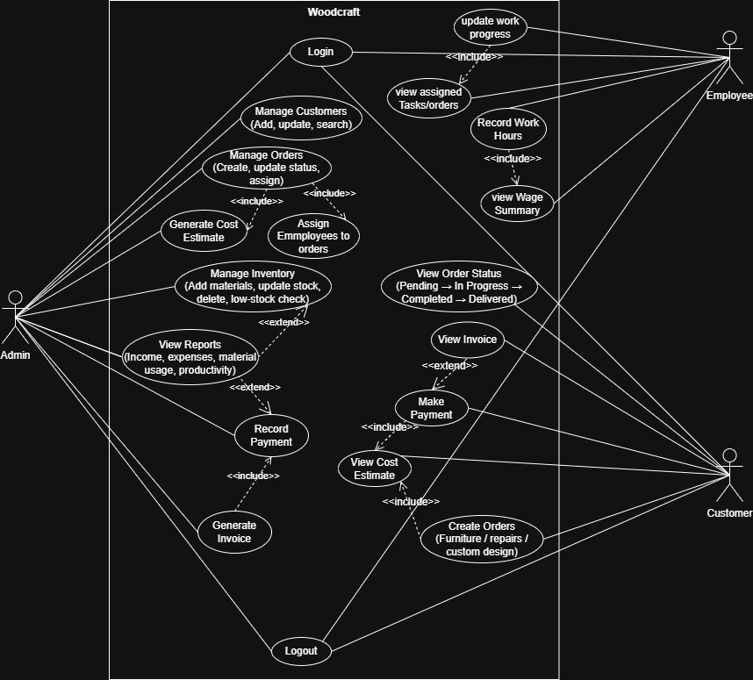
Use Case Diagram

Slide 12
Functional Requirements
Functional requirements define what the system must do

Slide 13


Core Functional Requirements
Order Lifecycle: Track from Pending to Delivery status.
Inventory Monitoring: Automatic stock reduction and low-stock alerts.
Cost Estimation: Dynamic calculation based on materials and labor.
Billing: Auto-generated invoices and payment history.

Slide 14


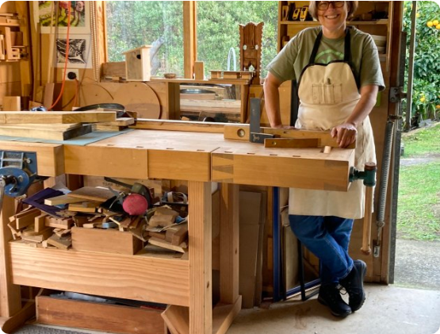
Customer & Order Lifecycle
Identity & Profiles: Secure registration, authentication, and full administrative oversight of user accounts.
Commission Creation: Integrated workflows for furniture orders, repair requests, and custom designs.
Real-time Tracking: Live order status flow (Pending, In Progress, Delivered) with unique Order ID auditing.
Intelligent Estimation: Automated cost generation based on live material stock and labor hours.

Slide 15
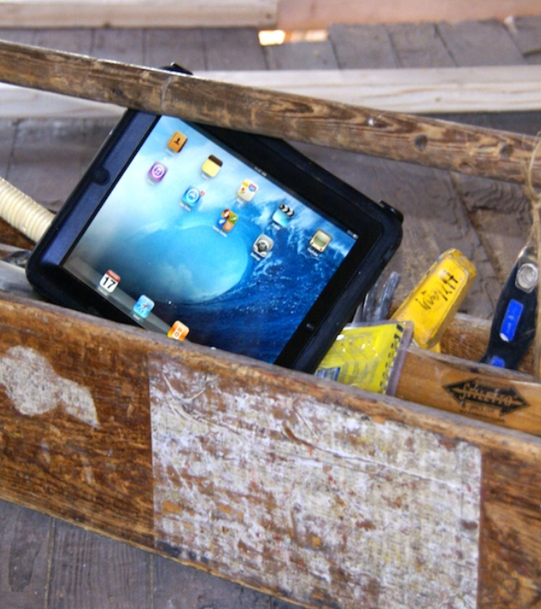
Employee Portal
Labor & Progress Tracking
Artisans log in to see their specific assignments. This eliminates verbal instructions and ensures every task is documented.
Worklogs: Employees record their hours, which are then used by the system to auto-calculate wages, ensuring fairness and accuracy.

Slide 16
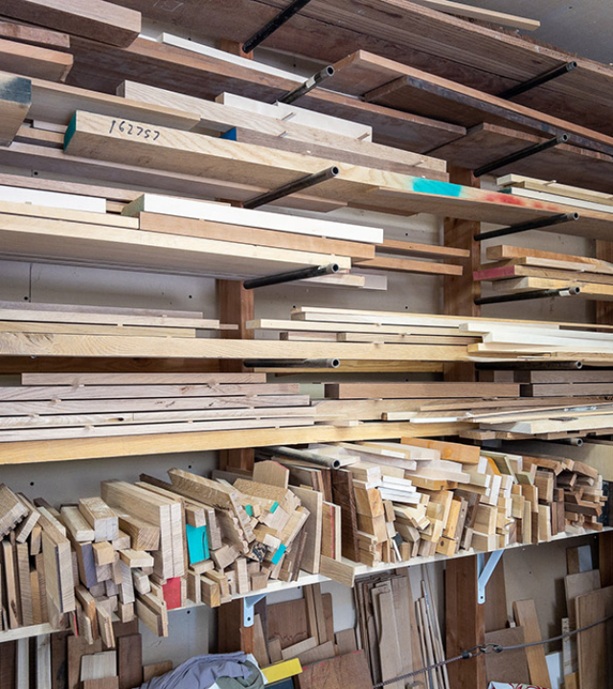
Inventory Intelligence
Material Catalog: Tracking wood types, hardware, finishes, and consumables.
Auto-Stock Updates: Automatic depletion of materials upon assignment to an order.
Low-Stock Awareness: Real-time alerts when inventory falls below minimum thresholds.

Slide 17






User Role Framework
Admin
Customer
Employee
Full control over users, approvals, inventory, and comprehensive financial reports.
Places commissions, tracks order progress in real-time, and manages billing/receipts.
Views assigned tasks, logs daily work hours, and tracks wage calculations.

Slide 18
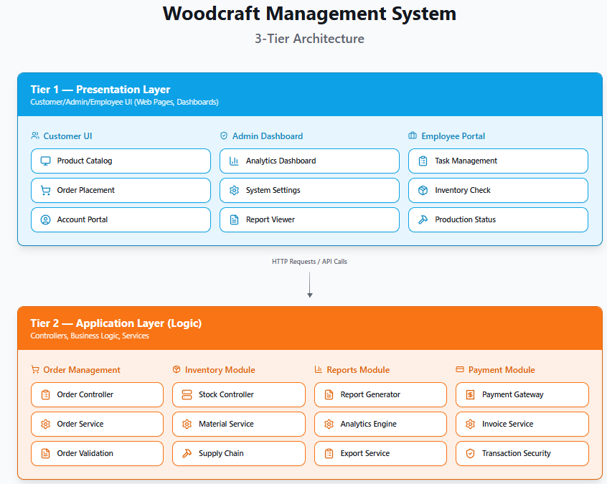
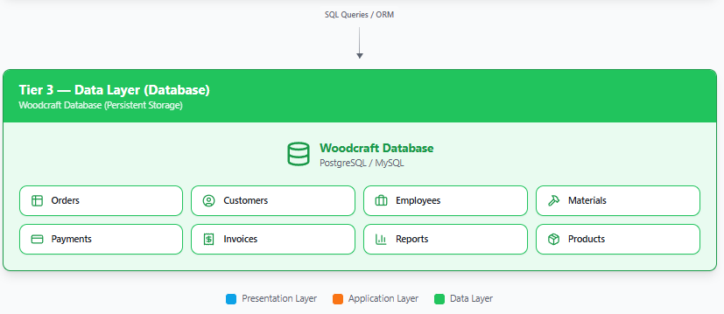
Architecture Diagram

Slide 19







Single Developer Framework
Technical Lead
Database Architect
UI/UX Designer
Developing the core logic with React 18 and Node.js, ensuring a seamless full-stack integration.
Designing MySQL relational structures for persistence, integrity, and complex billing queries.
Crafting role-aware interfaces using Tailwind CSS and shadcn/ui for intuitive workshop management.

Slide 20
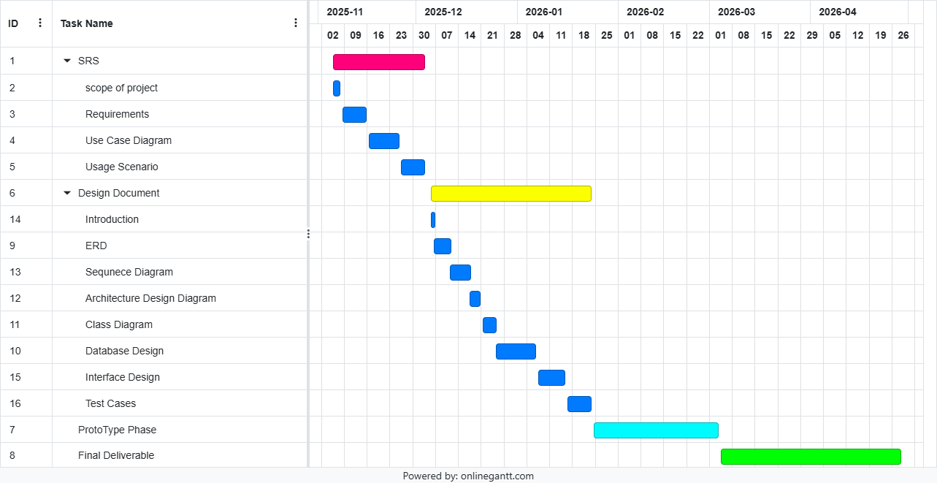
Project Schedule (Gantt Chart)

Slide 21
Sequence Diagrams of each Case
Sequence diagrams depict how system components interact over time to complete a particular use case.

Slide 22
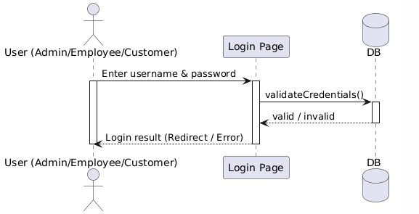
Sequence diagrams (Login/Register)

Slide 23
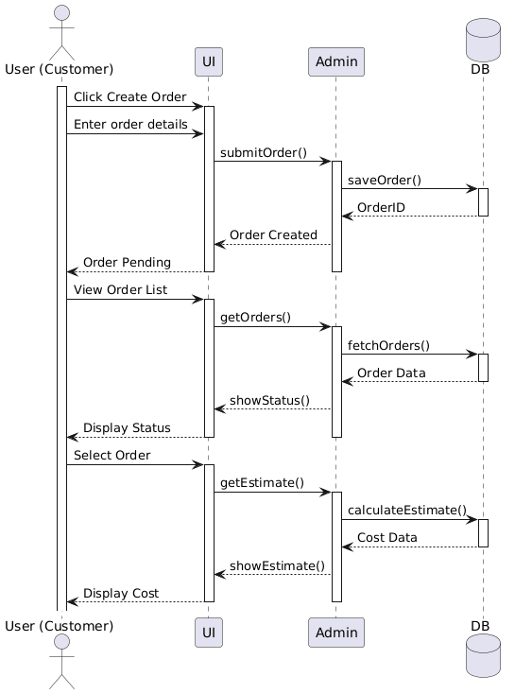
Sequence diagrams (Customer Initiates order)

Slide 24
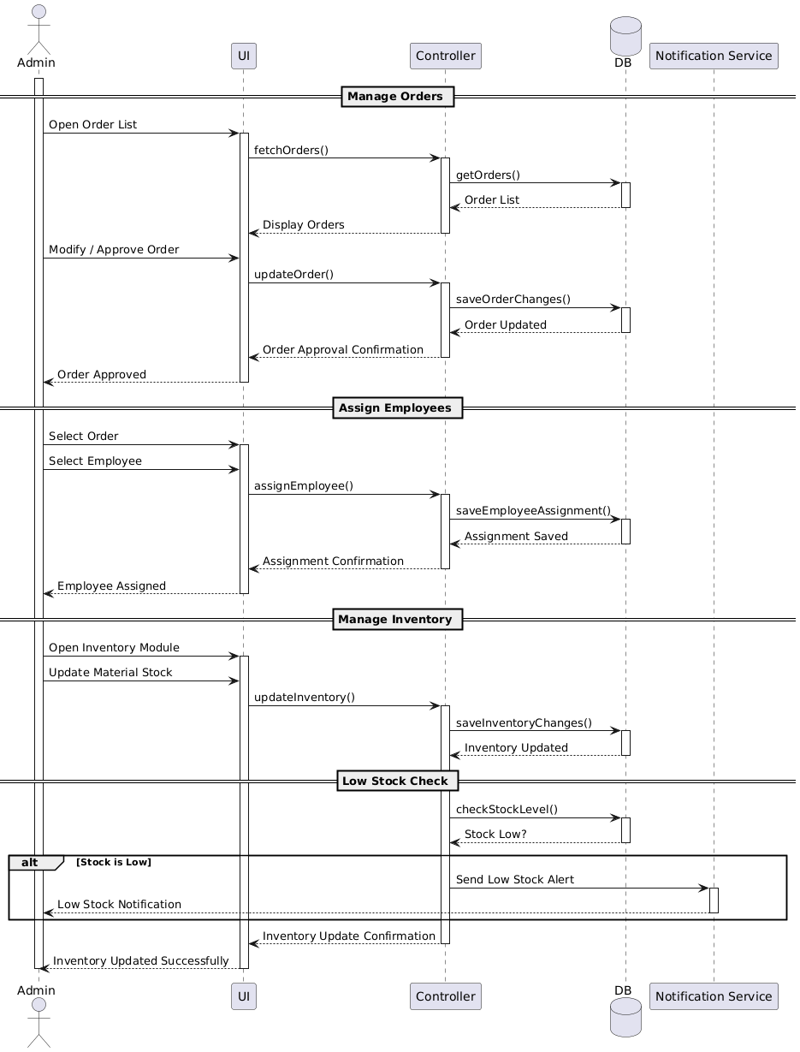
Sequence diagrams (Admin Order Processing)

Slide 25
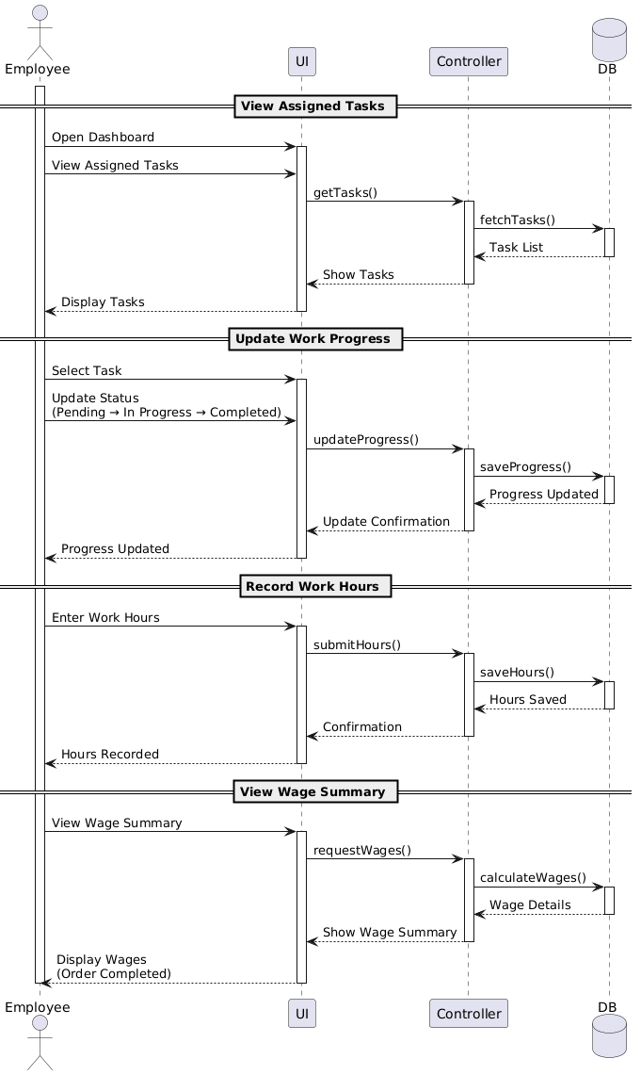
Sequence diagrams (Employee’s Order)

Slide 26
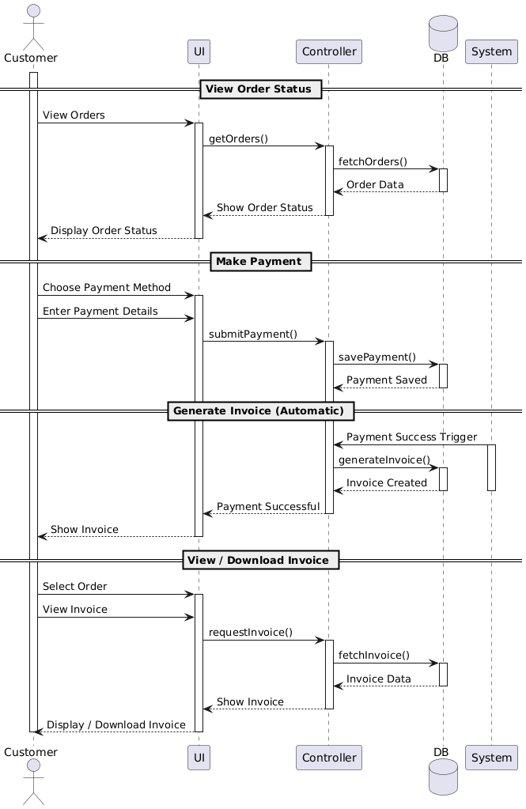
Sequence diagrams (Payment by Customer)

Slide 27
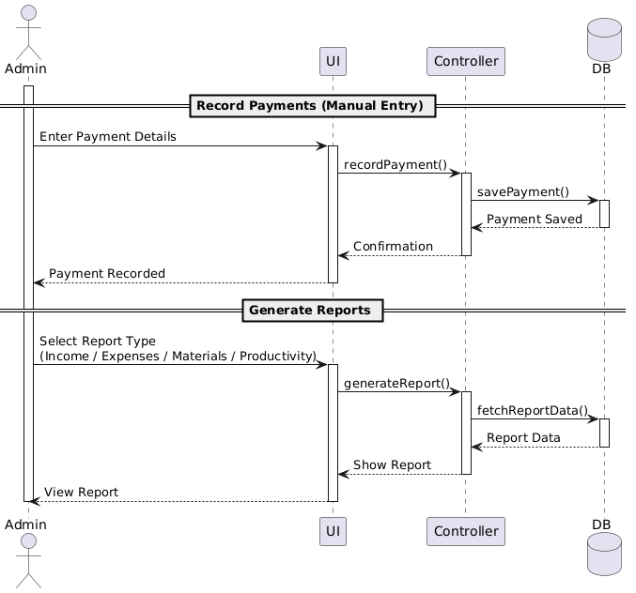
Sequence diagrams (Reports generation after payment)

Slide 28
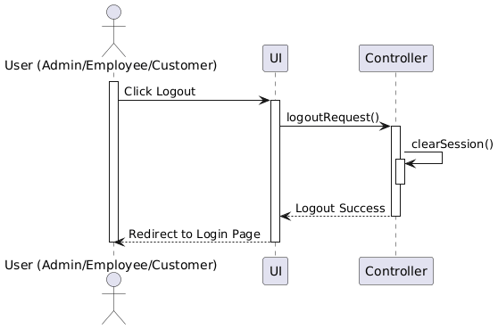
Sequence diagrams (Logout)

Slide 29
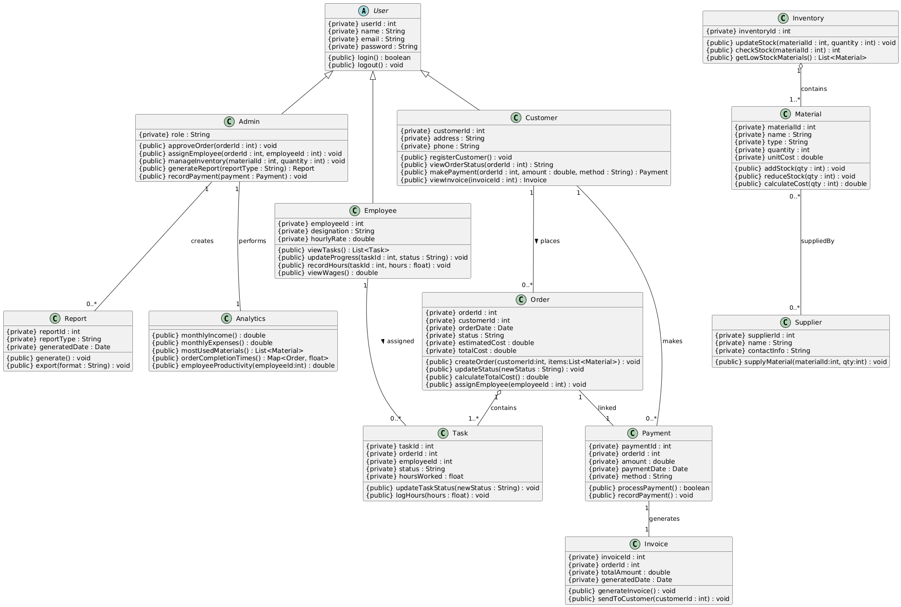
Class Diagram

Slide 30
Class Diagram

Slide 31
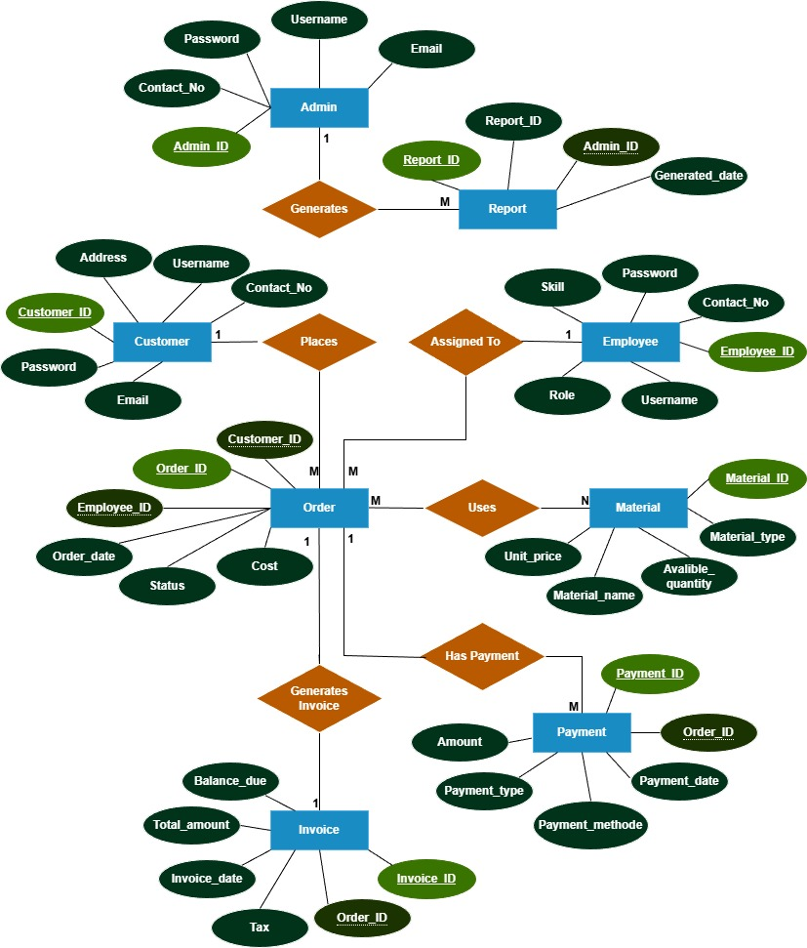
Entity-Relationship Diagram

Slide 32
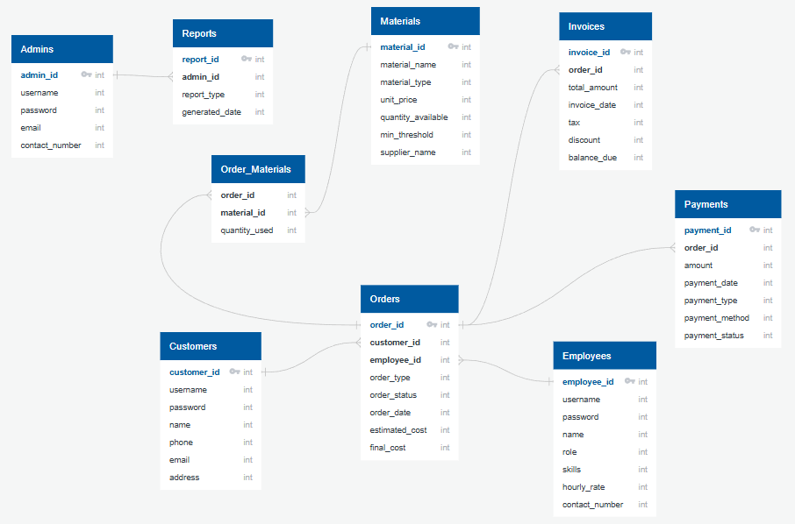
Database Diagram

Slide 33
Graphical User Interface
Woodcraft Web Application

Slide 34

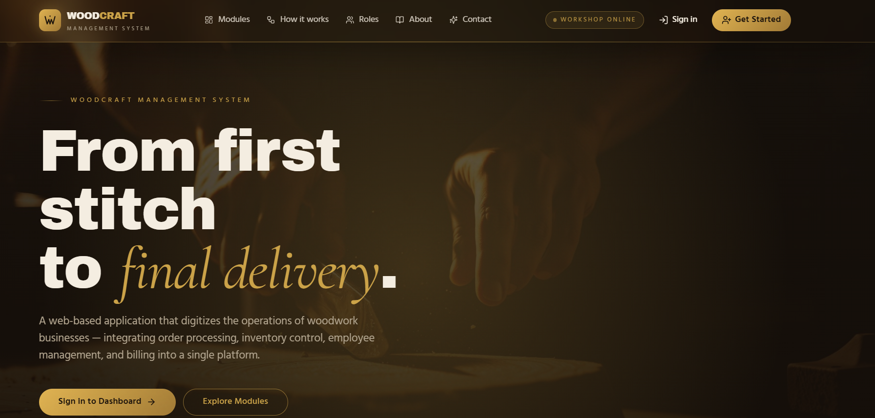
HomePage:

Slide 35
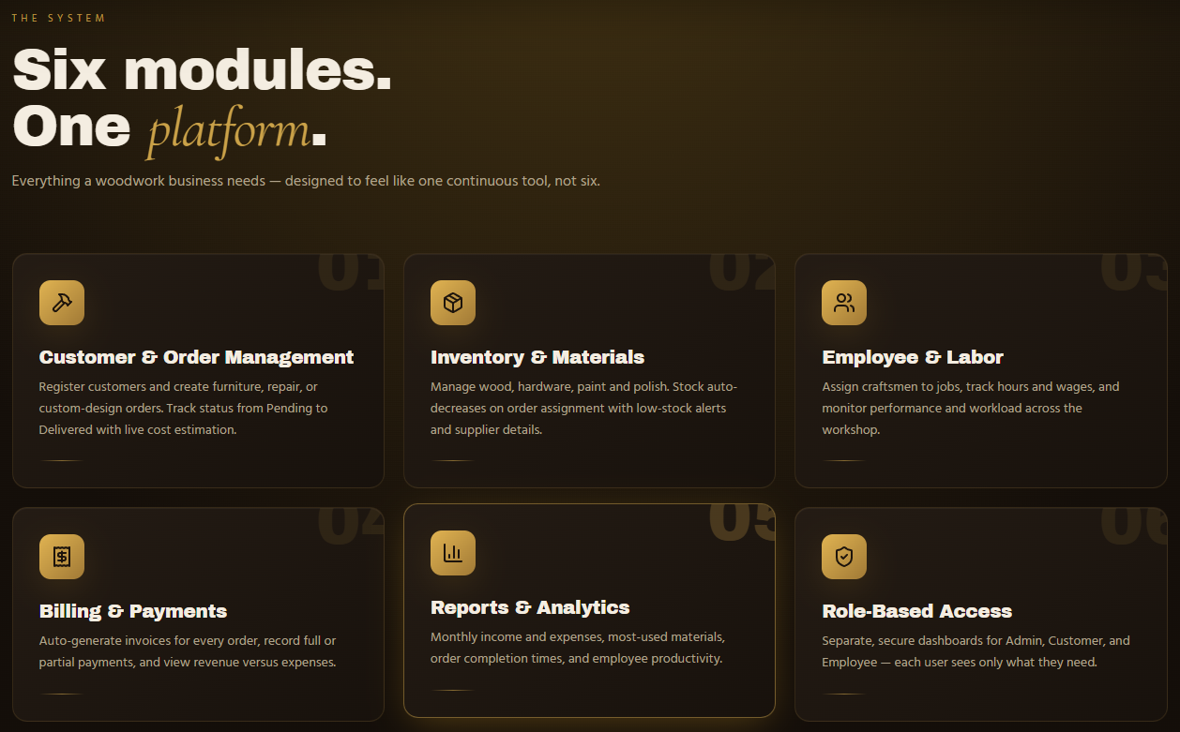
HomePage:

Slide 36
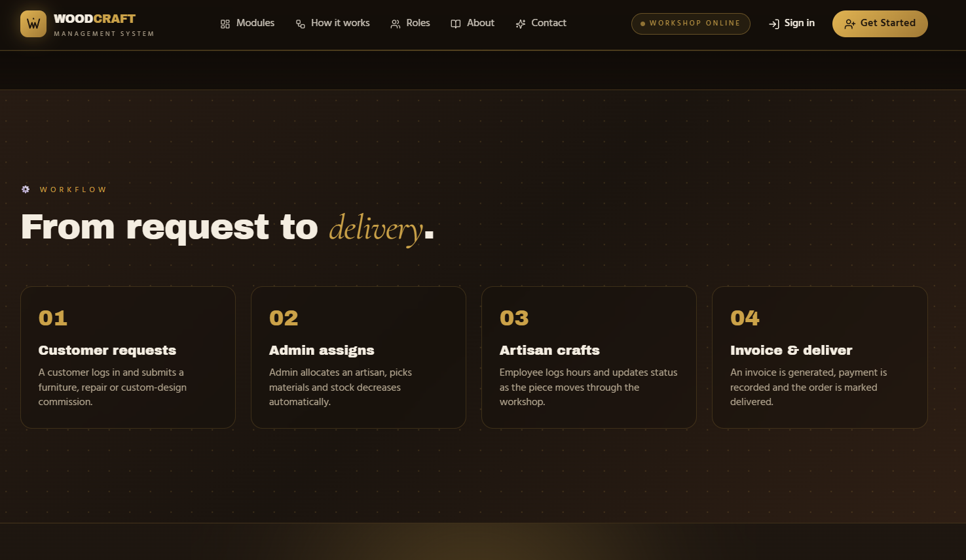
HomePage:

Slide 37
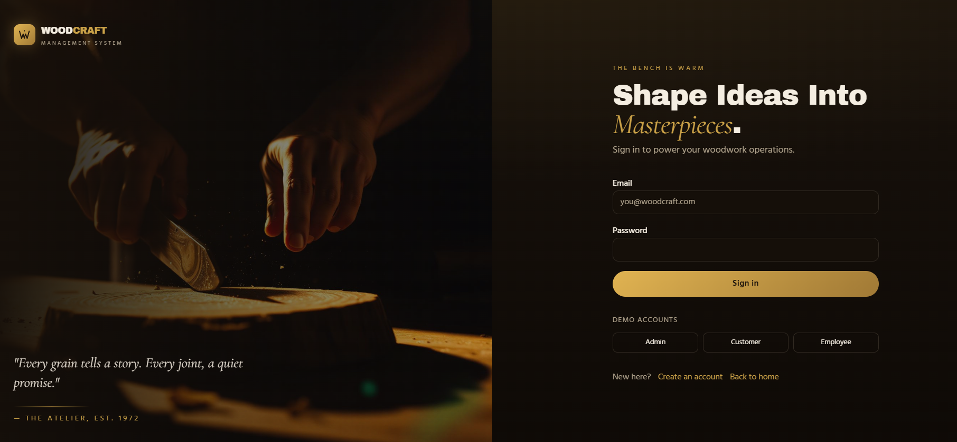
Login Page:

Slide 38
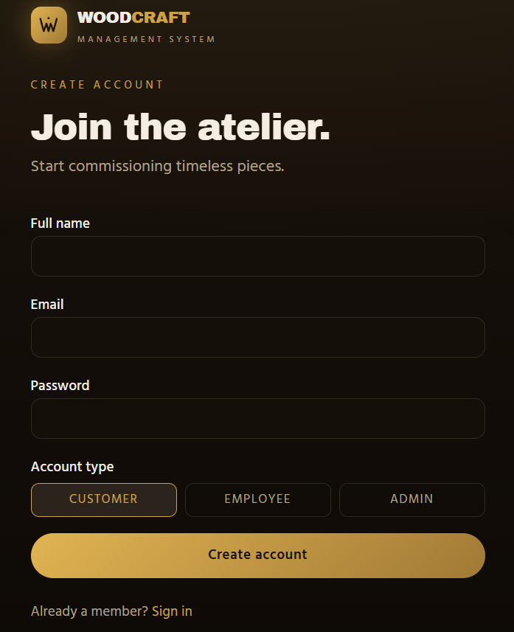
Register New Accounts

Slide 39
Login Page:

Slide 40
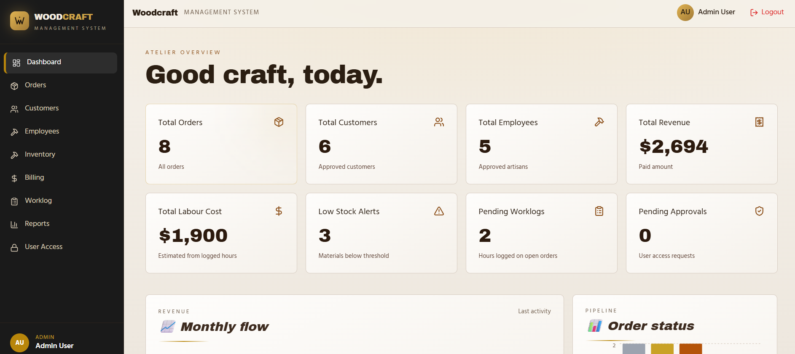
Admin Account

Slide 41
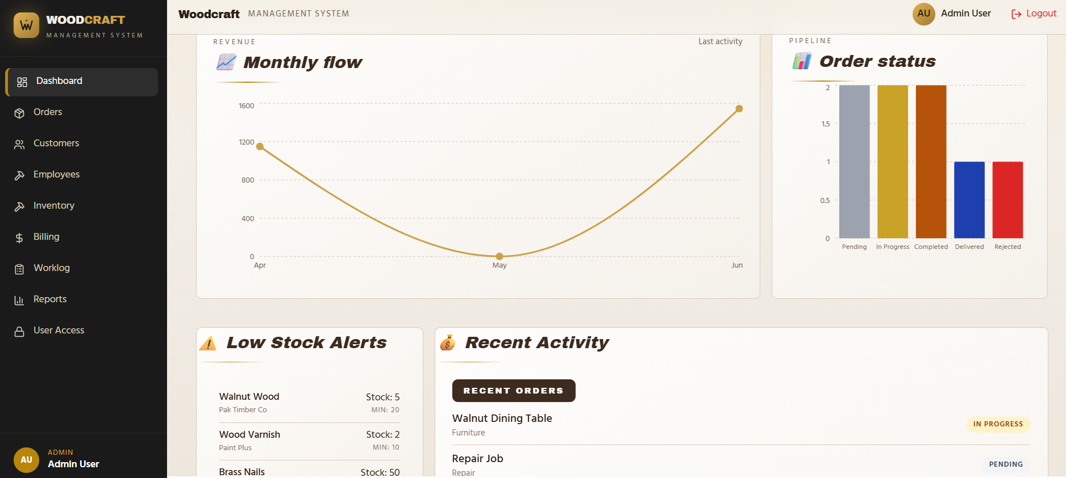
Admin Account

Slide 42
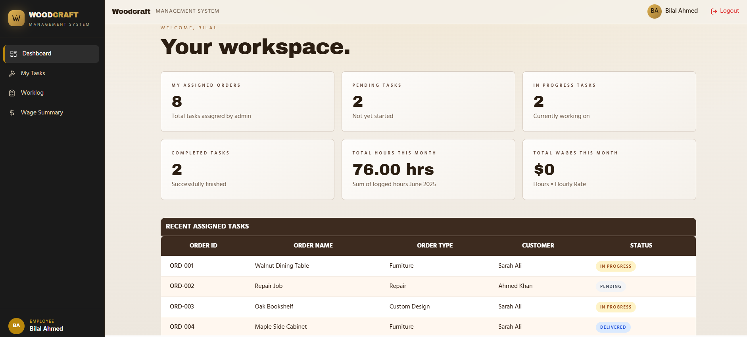
Employee Account

Slide 43
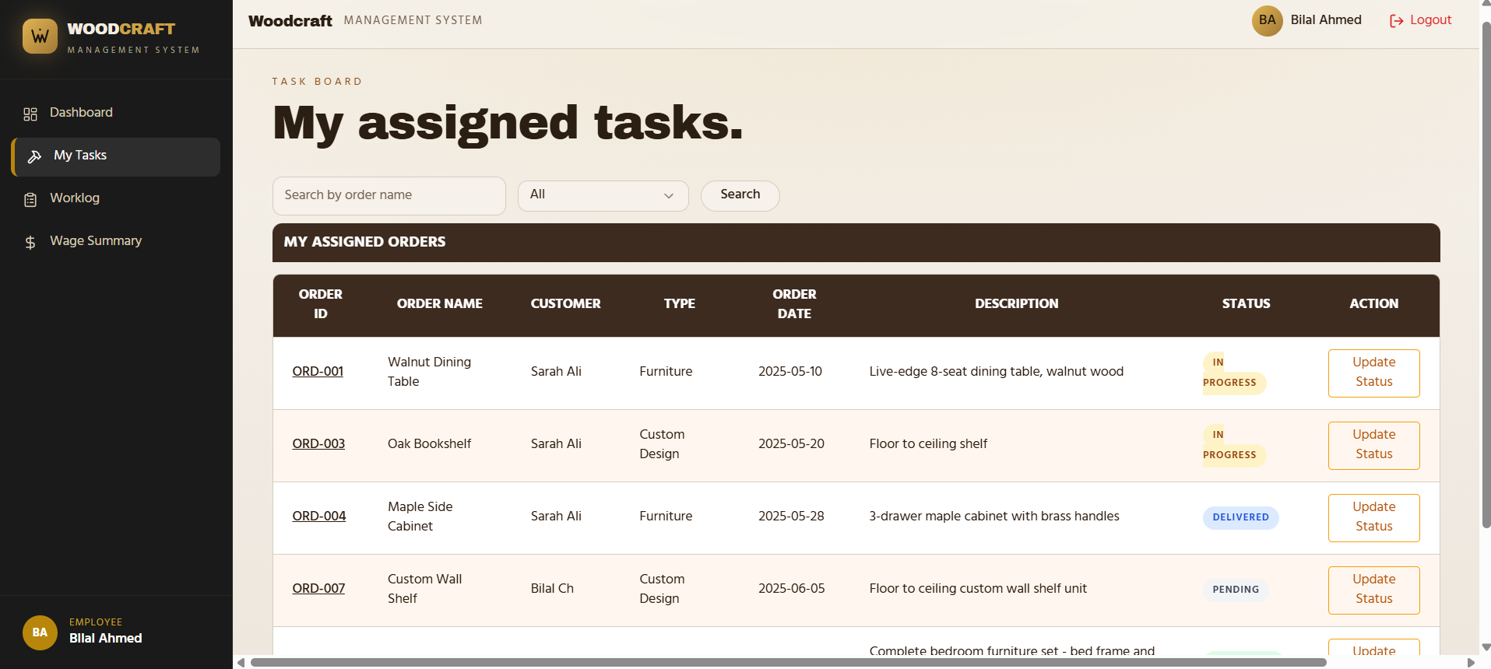
Employee Account

Slide 44
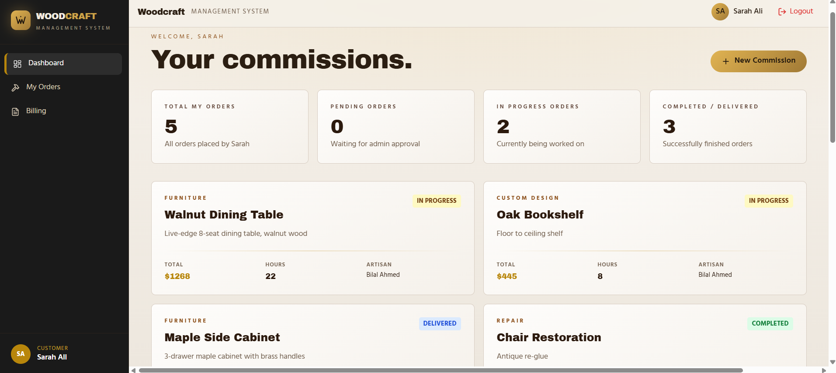
Customer Account

Slide 45
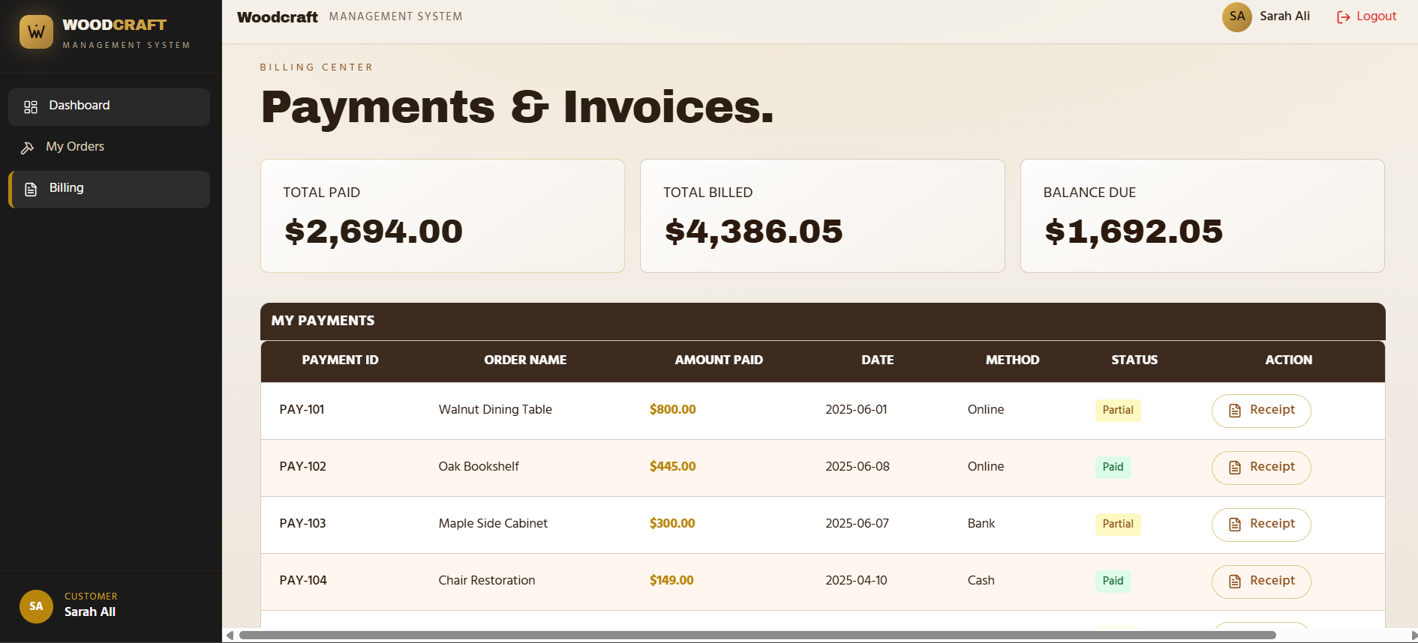
Customer Account

Slide 46


Tool & Modern Tech Stack
Frontend: React 18, TypeScript, Vite, and Tailwind CSS for a performant UI.
Backend: Node.js & Express.js reference implementation.
Storage: MySQL with Relational Schema for data integrity.
Security: JWT for authentication and BCrypt for password hashing.

Slide 47



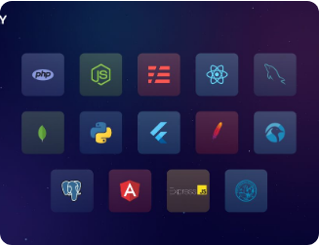



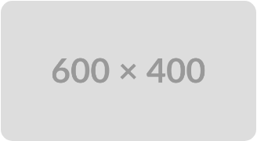
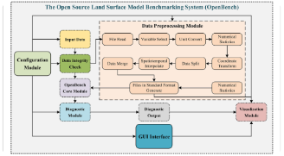
The Tech Stack
Frontend
Backend
Database
React 18, Vite, TypeScript, Tailwind CSS, shadcn/ui
Node.js, Express, JWT Auth, Bcrypt Security
MySQL Relational Schema for persistent storage

Slide 48
Thank You

